Slide 1
Measuring Changes in Twitter User Happiness in Response to Catastrophic Events

Slide 2
01.
04.
Introduction
Results
02.
05.
Related Research
Conclusion
03.
Methods
table of contents

Slide 3
01.
Introduction

Slide 4

Motivation
Rise of social media as the primary method of information diffusion.
Off-the-cuff and emotional nature of tweets
Advances in sentiment/happiness detection in natural language.
General advances in computational power and availability of data.

Slide 5
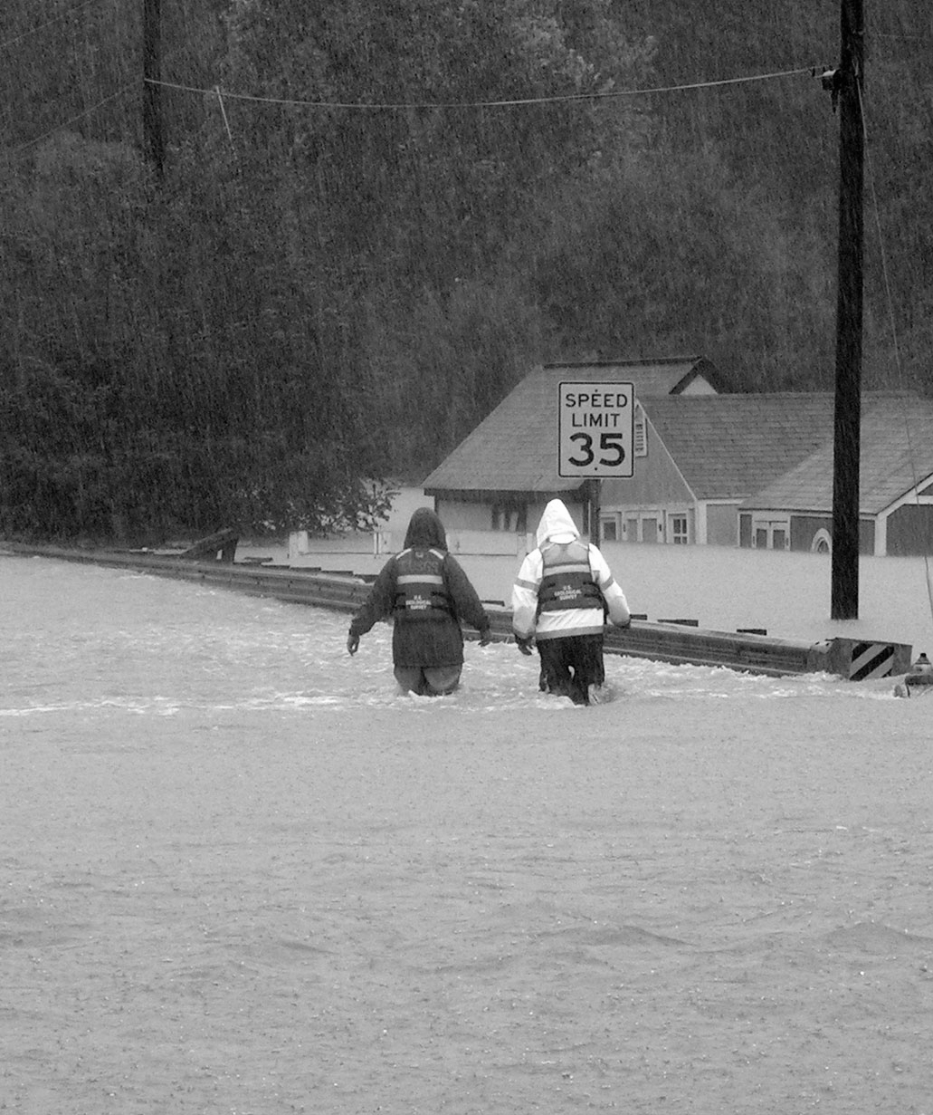

How does user happiness on Twitter change in response to positive/negative events?
Are there significant differences between the effects of man-made and natural disasters on Twitter user happiness?
How do the effects of positive and negative events on Twitter user happiness differ?
Key Questions

Slide 6
02.
Related Research

Slide 7
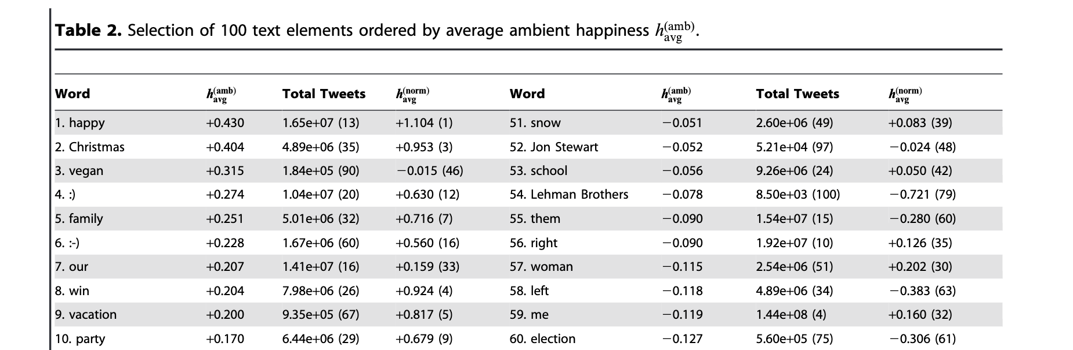
Related Research
Temporal Patterns of Happiness and Information in a Global Social Network: Hedonometrics and Twitter (Dodds et al)
Notes:
Since self reported assessment of happiness can be costly and misleading, we wanted to assess the happiness retrieve information from texts.
We used the same approach from the paper that we have read.
The obtained happiness from text sources by using the user scores assigned to individual words, for example this paper uses scores of good-bad, active-passive, and strong-weak on a scale of 1-9 by 0.5 increments, then computing a happiness valence for each word and using a weighted average.
This paper overall gives a simple, intuitive and effective method for computing the sentiment of larger texts.
The table is an example of each word assigned to a happiness score.

Slide 8
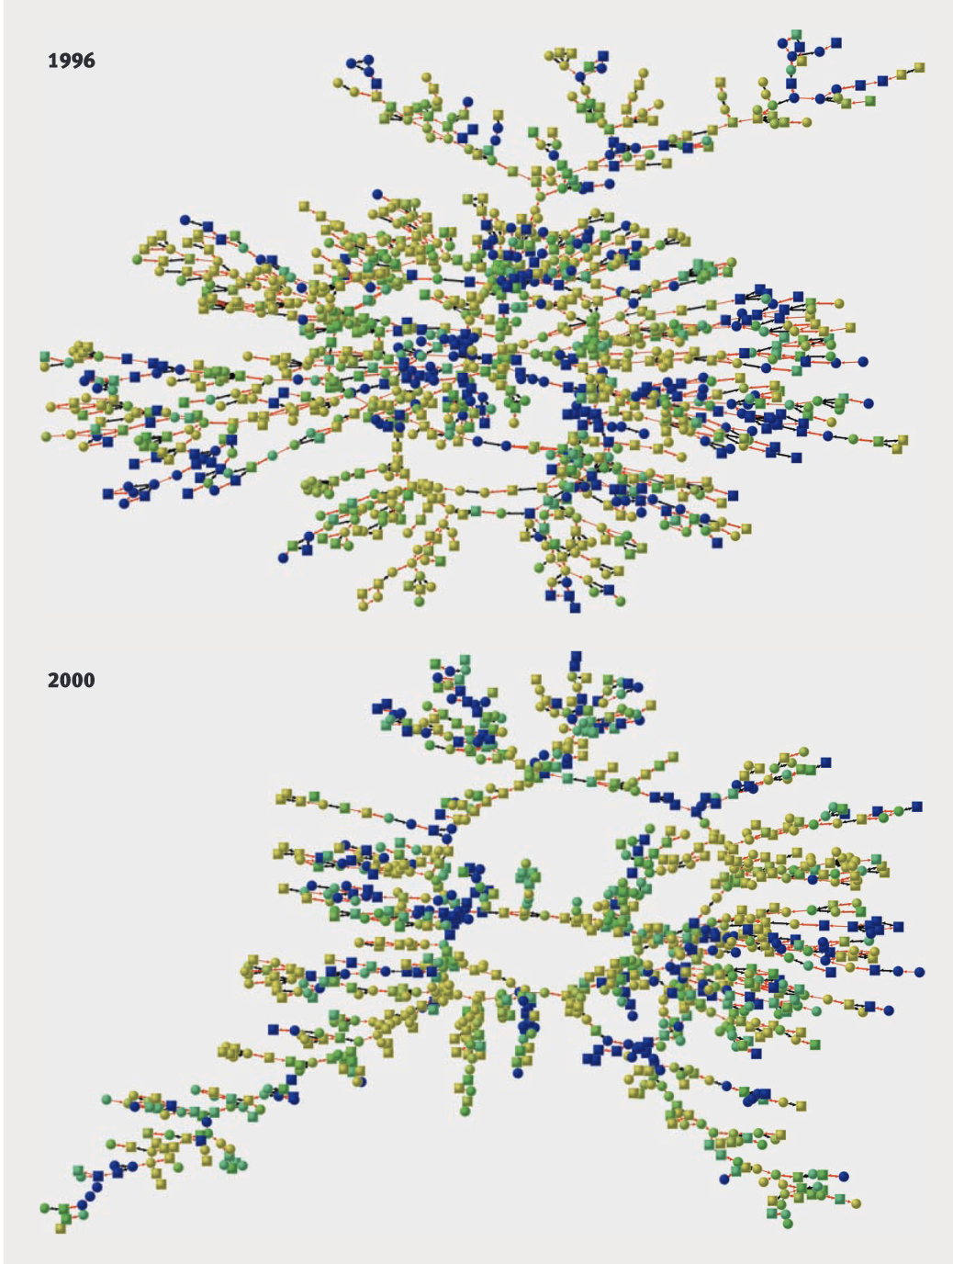
Related Research
Dynamic spread of happiness in a large social network: longitudinal analysis over 20 years in the Framingham Heart Study
(Fowler and Christakis)
Notes:
Clusters of happy and unhappy people are visible in the network, and the relationship between people’s happiness extends up to three degrees of separation (for
example, to the friends of one’s friends’ friends). People who are surrounded by many happy people and those who are central in the network are more likely to become happy in the future.
Lines between nodes indicate relationship blue shades indicate least happy and yellow shades indicate most happy (shades of green are intermediate)
Based upon the result of this paper, we expect that the catastrophic events will have an impact on the overall happiness of groups on Twitter as the users are connected to each other.

Slide 9
03.
Methods

Slide 10

Methods
Datasets
Cleaning
Scoring
Merged the two datasets used by [1]
Datasets included user location and tweet data.
Created a pipeline to clean tweets
Mildly computationally intensive
Scored tweet happiness on a scale from 1-9
Very computationally intensive
Notes:
paper is You Are Where You Tweet: A Content-Based Approach to Geo-locating Twitter Users in CIKM 2010.
(1) remove any mentions of other Twitter users, (2) remove any links in the tweet, (3) extract and save hashtags, (4) remove extra whitespace and/or special characters, (5) turn all words into lowercase, and (6) remove any words not in the lexicon

Slide 11
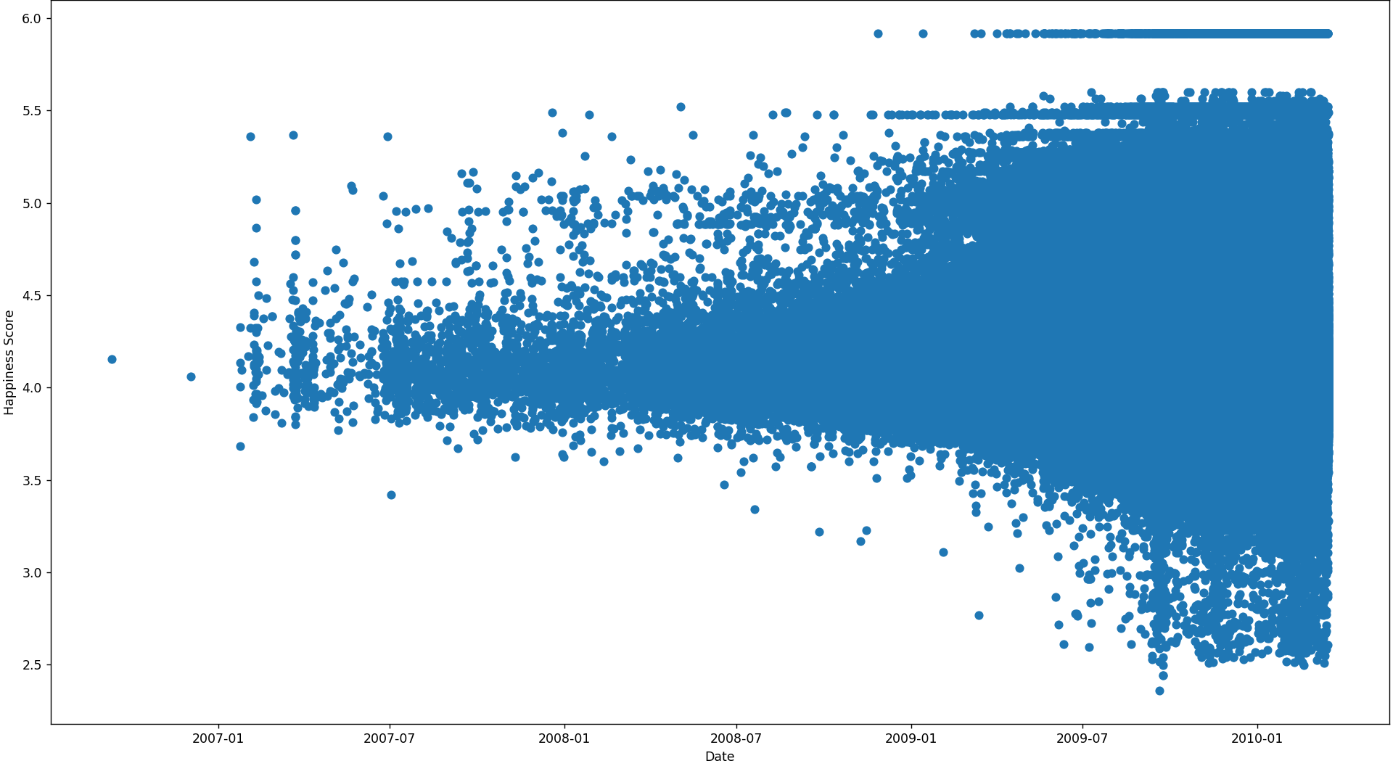
Methods
Datasets
Data was collected from September 9th, 2006 to March 17th, 2010, with the frequency of collection increasing over time
This data is a joining of 4 twitter datasets used by [1] as machine learning training and test sets
Notes:
We do this in order to compare the longer term, medium term, and short term impact of the events. We keep the longer term relatively small because we want to prevent other events from confounding our results.
We use normal t-test and welch’s t-test, because welch’s t-test is more robust. 5% significance level. For some of our analysis we also further filtered by location.
A limitation of our paper is that the keywords are completely arbitrary, using more/better keywords could have lead to more accurate results.

Slide 12
Methods
Hedonometer Scoring
The most popular words are given a happiness score my Amazon Mechanical Turk users in dataset used by [2]
We compute each tweet as a frequency vector weighted against the happiness scores, ignoring words that don’t pass the popularity threshold
Additionally compute ambient happiness by filtering for and removing keywords related directly to the event in question
Notes:
We do this in order to compare the longer term, medium term, and short term impact of the events. We keep the longer term relatively small because we want to prevent other events from confounding our results.
We use normal t-test and welch’s t-test, because welch’s t-test is more robust. 5% significance level. For some of our analysis we also further filtered by location.
A limitation of our paper is that the keywords are completely arbitrary, using more/better keywords could have lead to more accurate results.

Slide 13
Methods
Analysis
Gather tweets sent out in the following periods: 14-day period before/after event, 7-day period before/after event, and 3-day period before/after event.
Compare mean happiness of each pair of groups and find if the difference is significant using t-tests.
Repeat using only tweets that contained keywords related to the event and draw conclusions.
Notes:
We do this in order to compare the longer term, medium term, and short term impact of the events. We keep the longer term relatively small because we want to prevent other events from confounding our results.
We use normal t-test and welch’s t-test, because welch’s t-test is more robust. 5% significance level. For some of our analysis we also further filtered by location.
A limitation of our paper is that the keywords are completely arbitrary, using more/better keywords could have lead to more accurate results.

Slide 14
04.
Results

Slide 15
Effect of Negative Events on Happiness
01
2009 Southeastern United States Floods
02
2009 North American Blizzard
03
2009 Appomattox Shooting
04
2010 Fort Hood Shooting

Slide 16
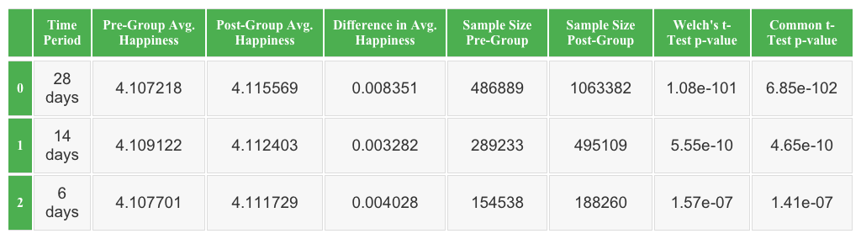
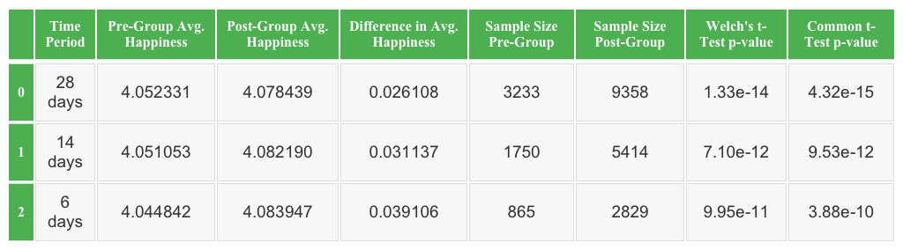
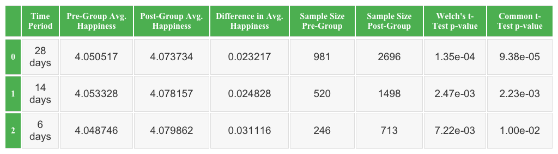
Effect of Negative Events on Happiness
For negative events, we could not find a significant impact on the user happiness.
It was not possible to exclude other significant events (ex. Halloween)
The sample size and p-value are too low to draw a statistically significant conclusion
2010 Fort Hood Shooting Statistics
All Tweets
Filtered Tweets
Filtered Tweets in the Nearby Region
Notes:
Table 8 shows the results of our analysis on the effect of 2010 Fort Hood Shooting, on the happiness of the population. The tables tell us that there is an overall increase in the difference in average happiness before and after the event for all three groups. We believe that these results come from the existence of confounding events like Halloween.

Slide 17
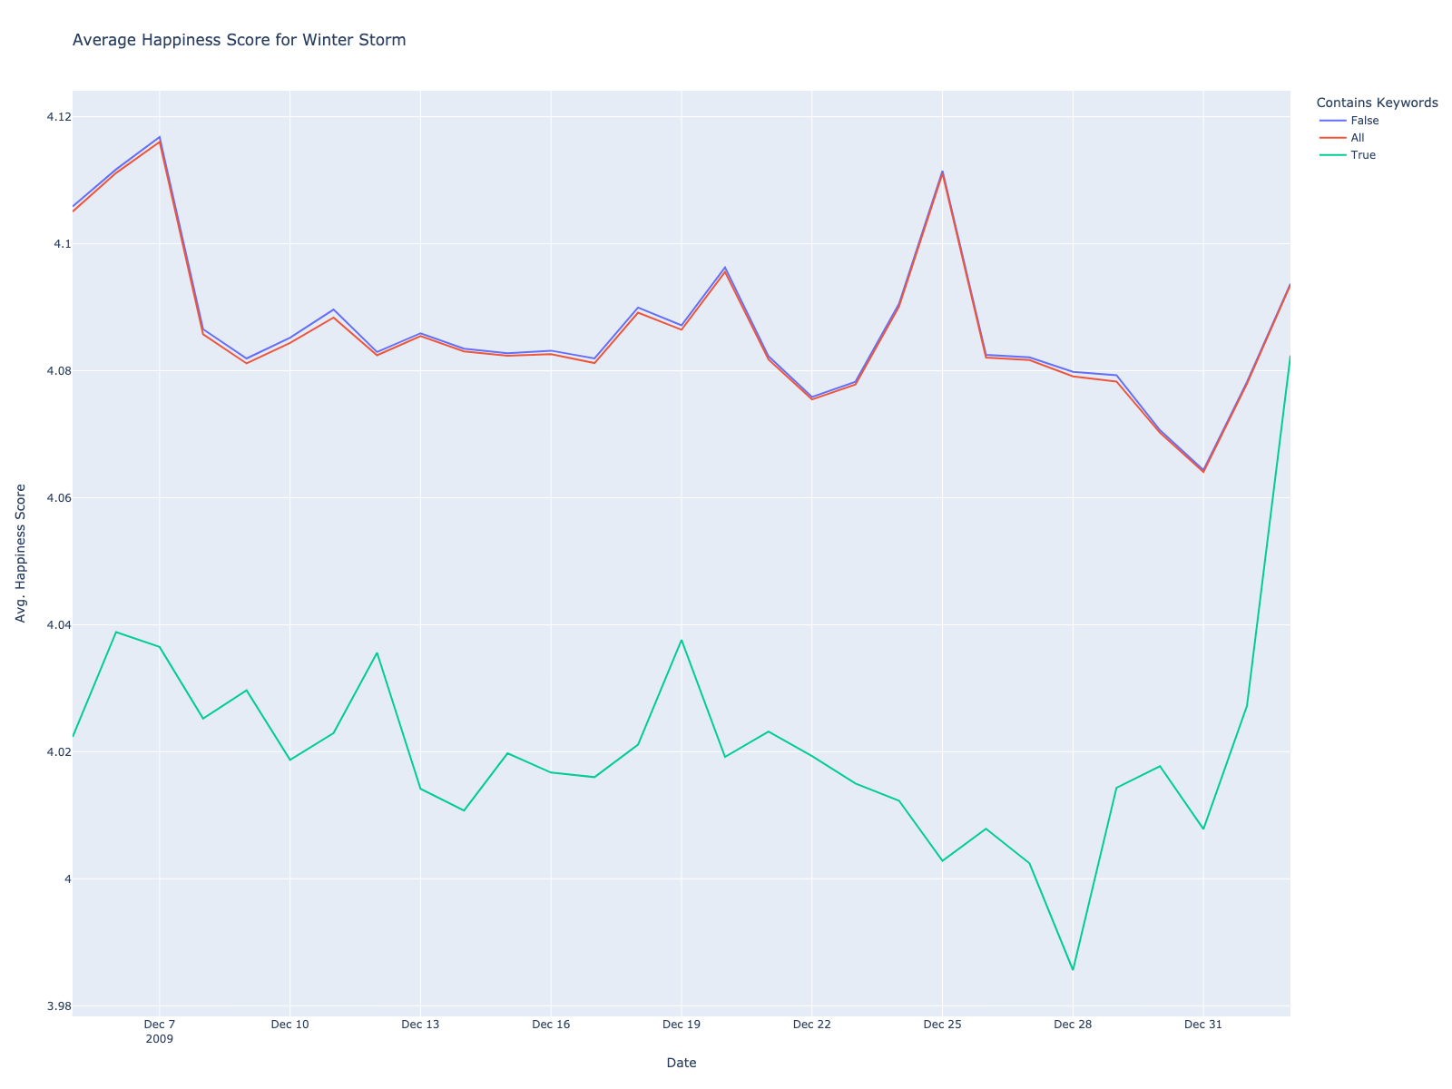
Effect of Negative Events on Happiness
Average Happiness Score for Winter Storm
The tweets that contain the keywords relevant to the event had lower happiness compared to the other groups.
Notes:
The plot shows the average happiness on the 14-day periods before and after the start of the 2009 North American Blizzard
We can observe that the tweets that contain the key words like “winter” and “storm” have lower happiness compared to the other two groups, which are all tweets, and the tweets that do not have the keyword.
This trend was visible for other cases too.

Slide 18
Man-Made vs Natural Disasters
There were no significant differences between Man-Made and Natural disasters’ impact on overall happiness levels.
Only analyzed over the tweets filtered by location and keywords
Analyzed with time frames of 28 days, 14 days, and 6 days before and after disasters.
All three groups had p-values ranging from .75 ~ .89
Notes:
Table 8 shows the results of our analysis on the effect of 2010 Fort Hood Shooting, on the happiness of the population. The tables tell us that there is an overall increase in the difference in average happiness before and after the event for all three groups. We believe that these results come from the existence of confounding events like Halloween.

Slide 19
Effect of Positive Events on Happiness
01
Christmas Day 2009
02
U.S. Independence Day 2009
03
NASA Space Launch Oct. 2009
04
Winter Olympics 2010

Slide 20
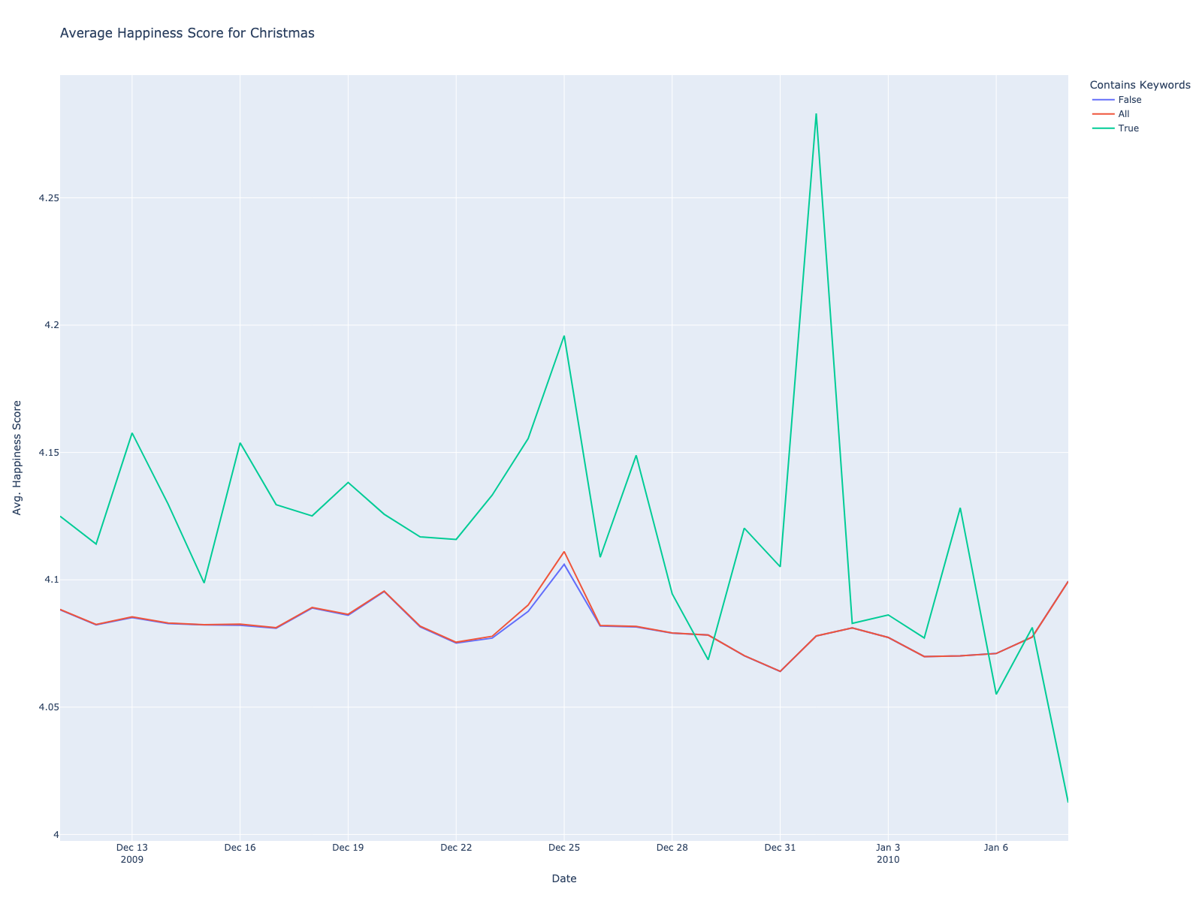
Effect of Positive Events on Happiness
Christmas Day 2009
Positive events tend to, at best, have a small impact on the overall happiness of a population
Effect seems to be short-lived and can lead to decreases in happiness afterwards.
Changes in ambient happiness before/after a positive event are more pronounced than those of overall happiness

Slide 21

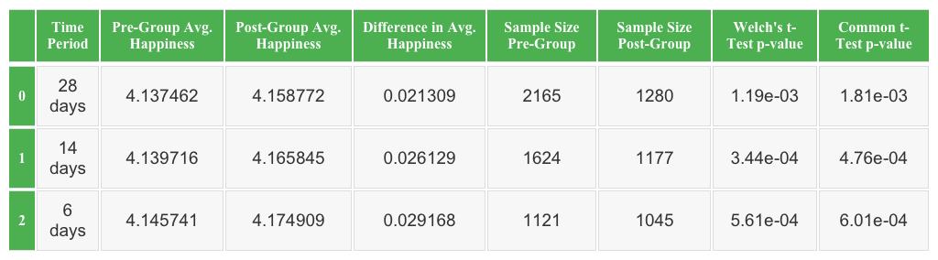
Effect of Positive Events on Happiness
Christmas Day 2009
Positive events tend to, at best, have a small impact on the overall happiness of a population
Effect seems to be short-lived and can lead to decreases in happiness afterwards.
Changes in ambient happiness before/after a positive event are more pronounced than those of overall happiness
All Tweets
Filtered Tweets

Slide 22
05.
Conclusion

Slide 23
Conclusions
Negative effects do not have have a statistically significant contribution to changes in overall happiness levels
There are no statistically significant differences between the effects of Man-made vs Natural disasters
Positive events tend to, at best, have a small impact on the overall happiness of a population
Notes:
We do this in order to compare the longer term, medium term, and short term impact of the events. We keep the longer term relatively small because we want to prevent other events from confounding our results.
We use normal t-test and welch’s t-test, because welch’s t-test is more robust. 5% significance level. For some of our analysis we also further filtered by location.
A limitation of our paper is that the keywords are completely arbitrary, using more/better keywords could have lead to more accurate results.

Slide 24
Conclusions
Limitations
Relatively small dataset
U.S. coverage
Time coverage of 1 year
Analyzed relatively small disasters
Future work question: Do large scale disasters affect happiness levels differently than small scale disasters
Notes:
We do this in order to compare the longer term, medium term, and short term impact of the events. We keep the longer term relatively small because we want to prevent other events from confounding our results.
We use normal t-test and welch’s t-test, because welch’s t-test is more robust. 5% significance level. For some of our analysis we also further filtered by location.
A limitation of our paper is that the keywords are completely arbitrary, using more/better keywords could have lead to more accurate results.

Slide 25
March 2009
March 2010
Appomattox
Fort Hood
9/11 Terrorism
Haiti Earthquake
Winter Storm
SE U.S. Floods
}
Death: ~250,000
Death: 2,996
Death: ~60

Slide 26

thank you!

Slide 27

[1] Z. Cheng, J. Caverlee, and K. Lee, “Twitter CIKM 2010,” Internet Archive,11-May-2011.[Online].Available: https://archive.org/details/twitter_cikm_2010. [Accessed: 26-Apr-2023].
[2] Dodds PS, Harris KD, Kloumann IM, Bliss CA, Danforth CM (2011) Temporal Patterns of Happiness and Information in a Global Social Network: Hedonometrics and Twitter. PLoS ONE 6(12): e26752. doi:10.1371/journal.pone.0026752
[3] Dodds PS, Danforth CM (2009) Measuring the happiness of large-scale written expression: Songs, blogs, and presidents. Journal of Happiness Studies.
[4] Fowler JH, Christakis NA (2008) Dynamic spread of happiness in a large social network: longitudinal analysis over 20 years in the Framingham Heart Study. BMJ 337: article #2338.
[5] Bollen J, Pepe A, Mao H (2011) Modeling public mood and emotion: Twitter sentiment and socio-economic phenomena. In: In Proceedings of the Fifth International AAAI Conference on Weblogs and Social Media (ICWSM). Barcelona, Spain.
[6] Mishne G, de Rijke M (2006) MoodViews: Tools for blog mood analysis. AAAI 2006 Spring Symposium on Computational Approaches to Analysing Weblogs.
[7] B. Pang and L. Lee, “Opinion mining and sentiment analysis.” [Online]. Available:https://www.cs.cornell.edu/home/llee/omsa/omsa-published.pdf. [Accessed: 29-Mar-2023].
[8] A. M. Sadiq, H. Ahn, and Y. B. Choi, “Human Sentiment and Activity Recognition in Disaster Situations Using Social Media Images Based on Deep Learning,” Sensors, 2022. [Online]. Available: https://www.ncbi.nlm.nih.gov/pmc/articles/PMC7763261/pdf/sensors-20-07115.pdf. [Accessed: 29-Mar-2023].
[9] Z. Cheng, J. Caverlee, and K. Lee, ‘You Are Where You Tweet: A Content-Based Approach to Geo-Locating Twitter Users’, in Proceedings of the 19th ACM International Conference on Information and Knowledge Management, Toronto, ON, Canada, 2010, pp. 759–7
[10] “United States Cities Database,” simplemaps. [Online]. Available: https://simplemaps.com/data/us-cities. [Accessed: 26-Apr-2023].
credits

